Slide 1
IVLP Pilot Data Logical Data Model
February 2015

Slide 2
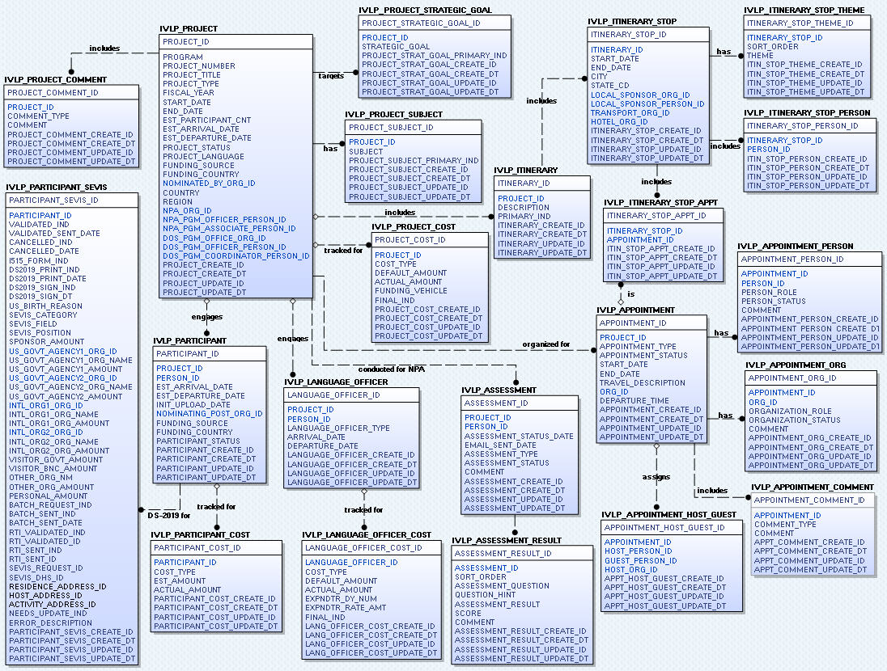
IVLP Logical Data Model: Project

Slide 3
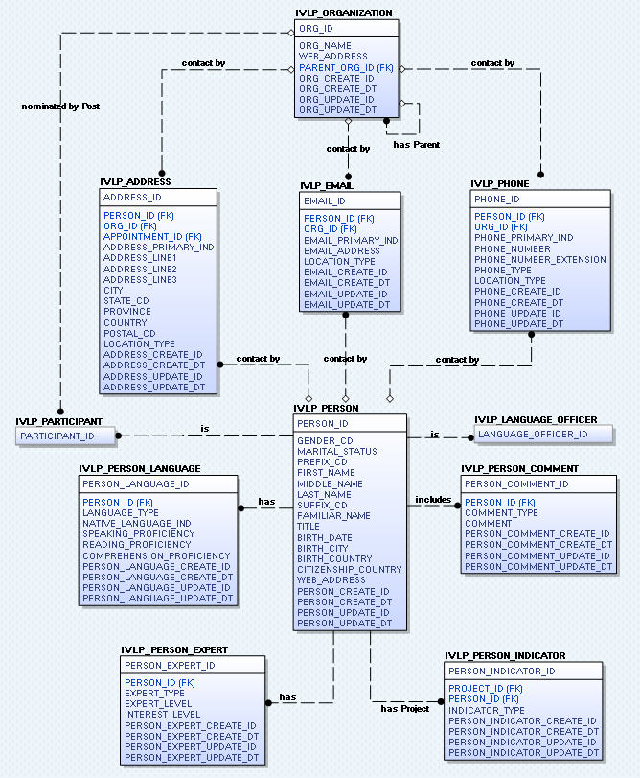
IVLP Logical Data Model:
Person & Organization

